Slide 1

Deploying Microsoft Azure Stack Hub
Azure Stack Hub Integration
This work is licensed under a Creative Commons Attribution - ShareAlike 4.0 International Public License

Slide 2
Agenda
Introduction
Datacenter integration
Networking Integration
AD & DNS
PKI & Certificates
Edge Deployment & ExpressRoute
Portal Authentication and Accessing Portals
IT Service Management & Monitoring Integration
Security Logs
Azure Stack Hub Datacenter Integration

Slide 3

Cloud operating model
operate
use
Azure
Azure customers
Microsoft engineers
use
operate
Azure Stack Hub instance
Your customers
Your engineers
Cloud Architect – Design
Cloud Operator – Operate Azure Stack Hub

Slide 4
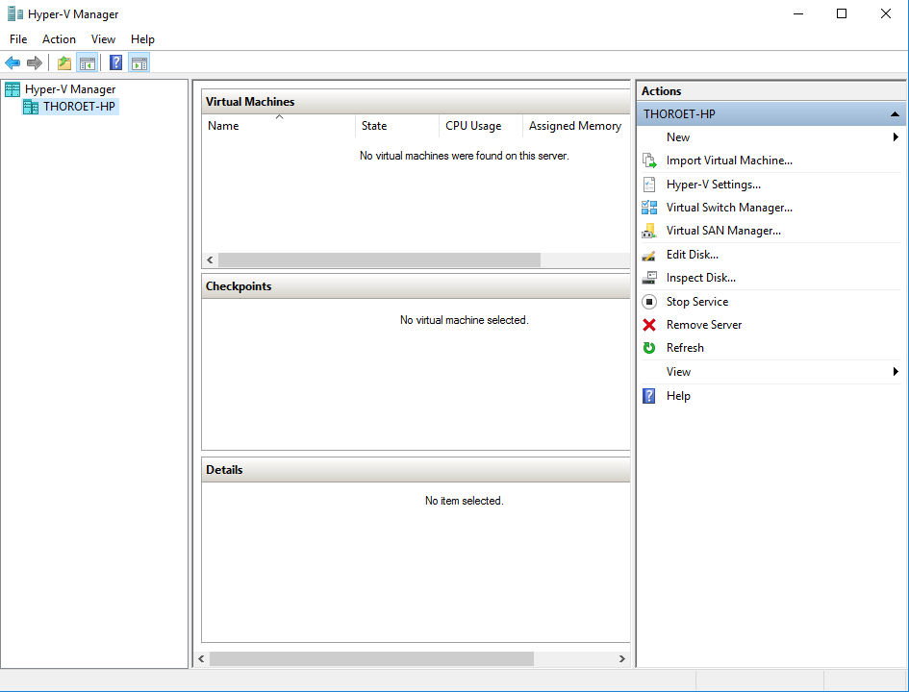
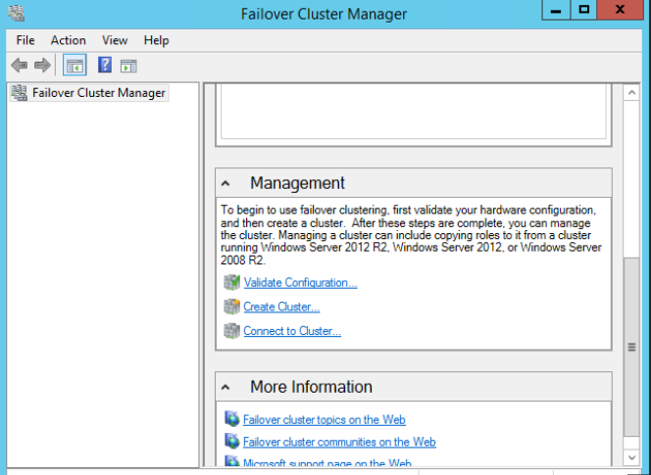
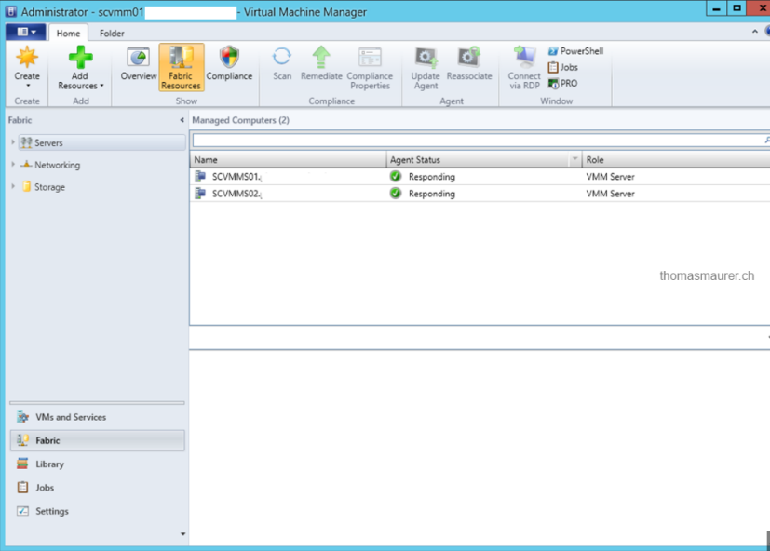
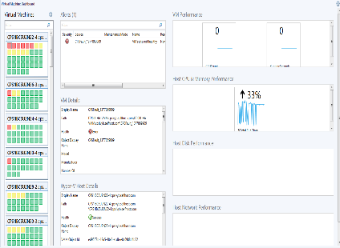
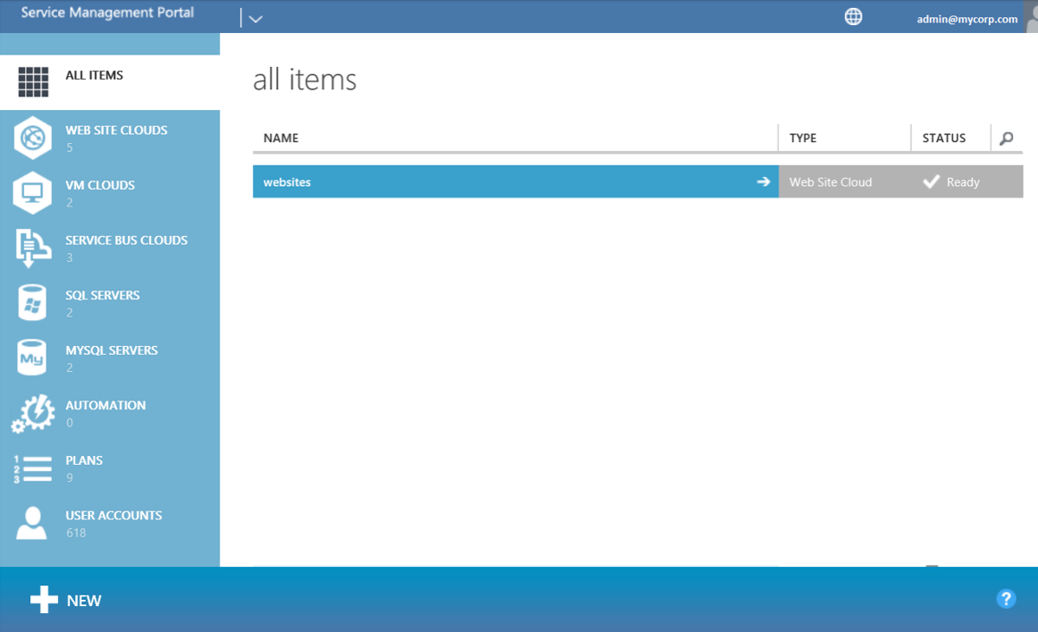
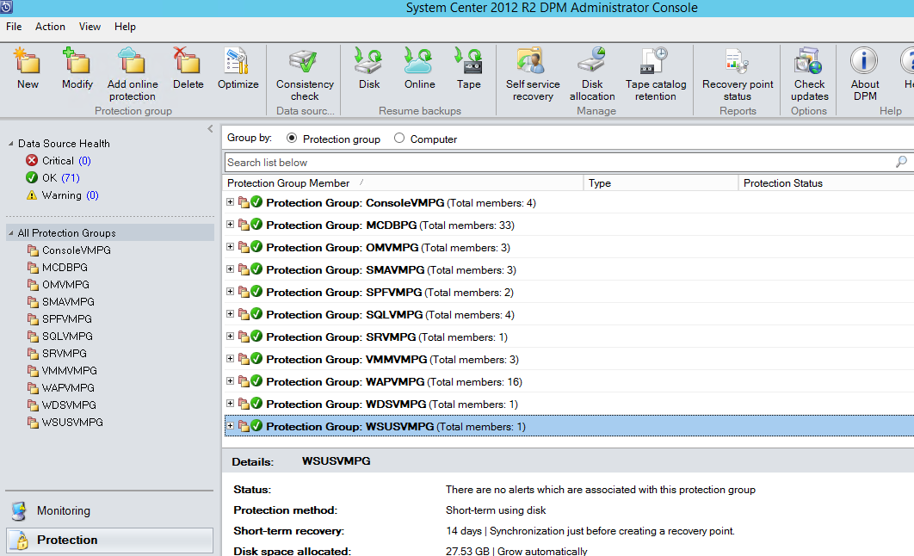
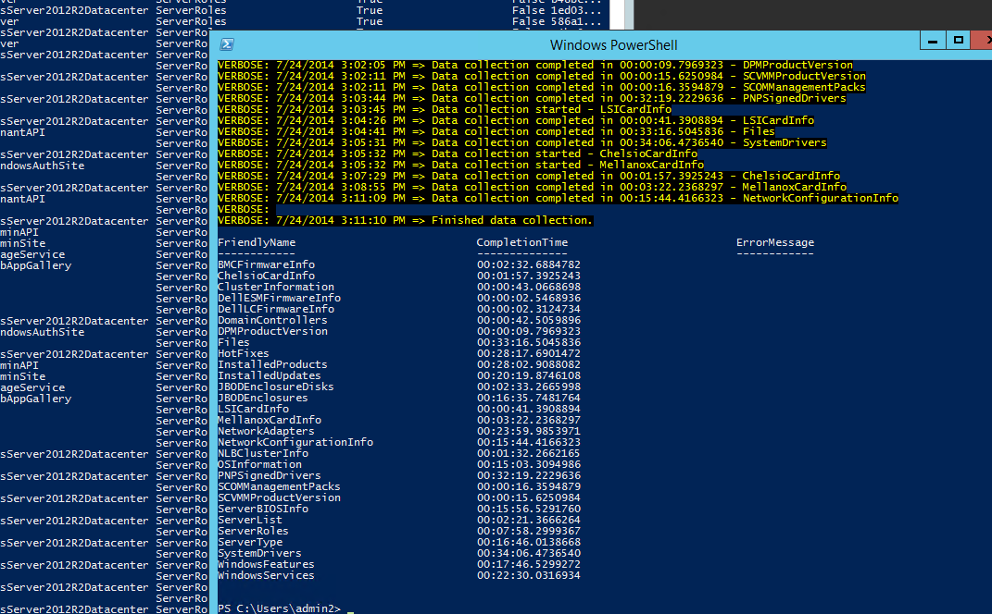
The toolbox of administrators today

Slide 5
Today’s infrastructure and cloud service mgmt.
Many silos of technology responsibility
Multiple points of infrastructure management UI and API
Deep knowledge required in each silo to operate
Not easily managed by a single administrator
Tenant Portals
Service 1
Service 2
Monitoring
Backup
Patching
Identity Mgmt
Database Mgmt
Security
Compute
Storage
Networking

Slide 6
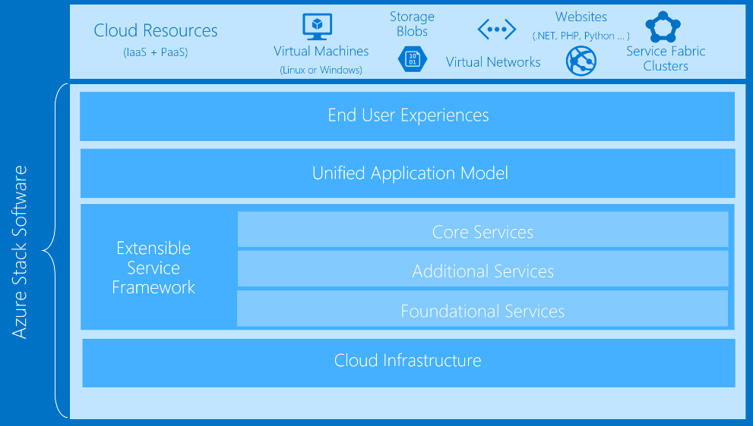
Cloud administration vision for Azure Stack Hub
Cloud Admins operate and troubleshoot across all infra
Single access point of infrastructure management UI and API
Fewer knobs to turn, deep silo knowledge not required to operate
Value to the business is Service SLA, not managing infrastructure

Slide 7
Datacenter Integration

Slide 8
Deployment and integration considerations
Identity
Tools and IDE
Monitoring
Azure Stack Hub
Networking
Billing

Slide 9
Typical datacenter integration touchpoints
IPv4
Network
Firewall
Identity
SSL
IP Space
Uplink
Publishing Rules
AAD / ADFS
SSL Certificates
DNS
NTP
Device Auth.
Syslog
ITSM /
Security
DNS
Time Server
Radius/TACAS*
Syslog Server*
ITSM Integration*

Slide 10
Network connectivity
Logical Network | Description | Size | Routed beyond TOR
Infrastructure | Used for Azure Stack Hub internal components to communicate. | /24 | Yes
BMC | Used to communicate with the BMCs on the physical hosts. | /27
Switch infrastructure | Point-to-point IP addresses for routing purposes, dedicated switch management interfaces, and loopback addresses assigned to the switch. | /26 | Yes
Public VIP | Public IP addresses for a small set of Azure Stack Hub services, with the rest used by tenant virtual machines. The Azure Stack Hub infrastructure uses 32 addresses from this network. If you plan to use App Service and the SQL resource providers, 7 more addresses are used. Advertised as individual /32s | /26 (62 hosts) - /22 (1022 hosts) Recommended = /24 (254 hosts) | Yes
Private VIP | Used for the storage network, private VIPs, Infrastructure containers and other internal functions. Starting in 1910, the size for this subnet is changing to /20, | /20 | Yes
Network integration planning for Azure Stack Hub - Azure Stack Hub | Microsoft Docs

Slide 11
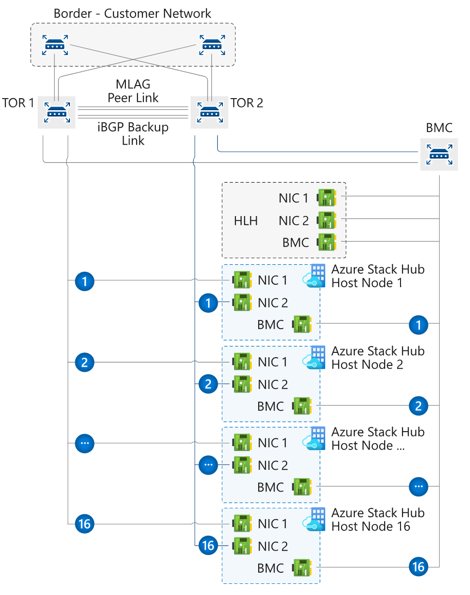
Uplink (integration with the border switches)
L3, Point-to-Point
IP subnet size /30
Routing Protocol
BGP (recommended) or Static Routing
External, infrastructure
16 Bit ASN (public or private)
New: Support different ASN per border device
Static Routing
TOR
Single static route to Border
ACL prevent certain networks to leave TOR
Border:
Static routes to P2P

Slide 12




Networking integration considerations
Time Server specified at deployment but also used for Physical Network Switches:
Time across all infrastructure elements is key
Kerberos time variance (5 min)
Server nodes and fabric VMs all configured for UTC – portal exposes only correct local time to users
Supports existing logging infrastructure for:
Physical network switches
Baseboard Management Controller (BMC)
OEM Tools
Supports existing infrastructure of:
Radius with MSCHAPv2
TACACS

Slide 13
AD supported versions
Supported version of Microsoft Active Directory:
2012 / 2012 R2 / 2016 / 2019
Supported Versions of AD FS:
Windows Server 2012 / 2012 R2 / 2016 / 2019
Single Active Directory Forest for AD Graph
Forest and Domain functional levels: Minimum 2012

Slide 14
Customer corporate AD requirements
AD Graph service does the look up users for RBAC scenarios
AzS internal-AD is always pre-configured (and not exposed outside of Azure Stack Hub)
LDAP is used to connect to Corporate AD
Graph Service Requirements
The Graph service requires a service account with read-only access to the target Active Directory forest
The Graph service can only communicate with a single Active Directory Domain Services (AD DS) forest
The Graph service requires access to an AD DS global catalog server
You should create an AD site in your AD that includes the subnets where Azure Stack Hub resides. This allows Azure Stack Hub’s LDAP queries to find the closest AD global catalog server
Directory Service
AD Graph
LDAP
TCP 389/636 and 3268/3269

Slide 15
Validate Identities
Azure Stack Hub Readiness Checker tool (AzsReadinessChecker)
Can Validate Integration of
Azure Active Directory (AD)
Active Directory Federation Services (AD FS)
Active Directory (AD) Graph
Reports and Log Files
AzsReadinessChecker.log and AzsReadinessCheckerReport.json
Report provides confirmation of the identity configuration

Slide 16
DNS services in Azure Stack Hub
Azure Stack Hub DNS namespace
Field | Description | Example
Region | The geographic location of your Azure Stack Hub deployment. | east
External Domain Name | The name of the zone you want to use for your Azure Stack Hub deployment. | cloud.fabrikam.com
Internal Domain Name | The name of the internal zone that is used for infrastructure services in Azure Stack Hub. It is Directory Service-integrated and private (not reachable from outside the Azure Stack Hub deployment). | azurestack.local
DNS Forwarder | DNS servers that are used to forward DNS queries, DNS zones and records that are hosted outside Azure Stack Hub, either on the corporate intranet or public internet. You can edit the DNS Forwarder value with the Set-AzSDnsForwarder cmdlet after deployment. | 10.57.175.34 8.8.8.8
Naming Prefix (Optional) | The naming prefix you want your Azure Stack Hub infrastructure role instance machine names to have. If not provided, the default is azs. | azs

Slide 17
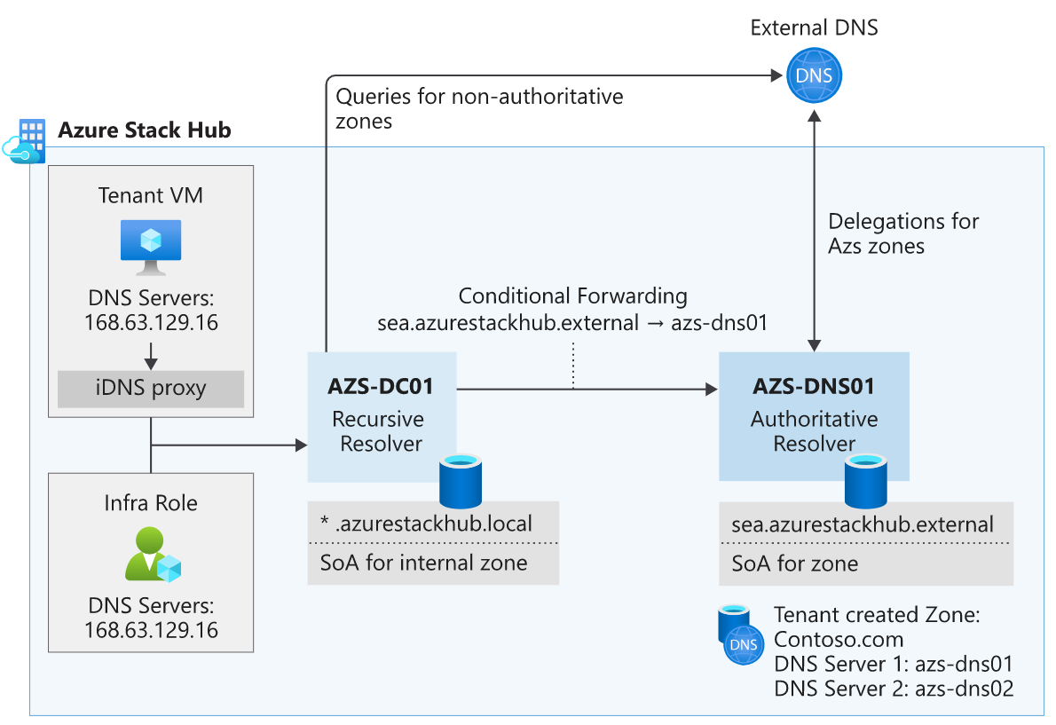
DNS Resolution and Delegation

Slide 18
DNS – Integration to resolve existing forest
Forwarding for external name resolution
Conditional forwarding to resolve corporate forest
To resolve Azure Stack Hub forest, it is a customer implementation choice
Conditional Forwarding, Delegation, Stub Zones, Root hints
Conditional Forwarding
Internal Zone
Customer Choice
Corp.local
External Zone

Slide 19
Azure Stack Hub PKI certificate requirements
Certificate requirements
Issued by: Internal Certificate Authority or a Public Certificate Authority
must have network access to the certificate authority's Certificate Revocation List (CRL) location published in the certificate
CRL must be an http endpoint.
Wild card: Single wild card covering all name spaces in the Subject Alternative Name (SAN) field.
Alternatively, you can use individual certificates using wild cards for endpoints such as storage and Key Vault where they are required
Signature: Cannot be SHA1, it must be stronger
File format: PFX (since both the public and private keys are needed)
Key usage: Digital Signature and Key Encipherment
PFX password: The passwords to all certificate pfx files must be the same
Subject: Ensure that the Subject Names and Subject Alternative Names of all certificates match the specifications described in this article to avoid failed deployments - https://docs.microsoft.com/en-us/azure/azure-stack/azure-stack-pki-certs

Slide 20
Azure Stack Hub PKI certificate requirements
Mandatory certificates
Deployment folder | Required certificate subject and subject alternative names (SAN) | Scope (per region) | SubDomain namespace
Public Portal | portal.<region>.<fqdn> | Portals | <region>.<fqdn>
Admin Portal | adminportal.<region>.<fqdn> | Portals | <region>.<fqdn>
Azure Resource Manager Public | management.<region>.<fqdn> | Azure Resource Manager | <region>.<fqdn>
Azure Resource Manager Admin | adminmanagement.<region>.<fqdn> | Azure Resource Manager | <region>.<fqdn>
ACSBlob | *.blob.<region>.<fqdn> | Blob Storage | blob.<region>.<fqdn>
ACSTable | *.table.<region>.<fqdn> | Table Storage | table.<region>.<fqdn>
ACSQueue | *.queue.<region>.<fqdn> | Queue Storage | queue.<region>.<fqdn>
KeyVault | *.vault.<region>.<fqdn> | Key Vault | vault.<region>.<fqdn>
KeyVaultInternal | *.adminvault.<region>.<fqdn> | Internal Keyvault | adminvault.<region>.<fqdn>

Slide 21
Azure Stack Hub PKI certificate requirements
Mandatory certificates
Deployment folder | Required certificate subject and subject alternative names (SAN) | Scope (per region) | SubDomain namespace
Admin Extension Host | *.adminhosting.<region>.<fqdn> (Wildcard SSL Certificates) | Admin Extension Host | adminhosting.<region>.<fqdn>
Public Extension Host | *.hosting.<region>.<fqdn> (Wildcard SSL Certificates) | Public Extension Host | hosting.<region>.<fqdn>

Slide 22
Azure Stack Hub PKI certificate requirements
Additional certificates for ADFS deployment
Deployment folder | Required certificate subject and subject alternative names (SAN) | Scope (per region) | SubDomain namespace
ADFS | adfs.<region>.<fqdn> (SSL Certificate) | ADFS | <region>.<fqdn>
Graph | graph.<region>.<fqdn> (SSL Certificate) | Graph | <region>.<fqdn>

Slide 23
Azure Stack Hub PKI certificate requirements
Optional PaaS certificates
Scope (per region) | Certificate | Required certificate subject and Subject Alternative Names (SANs) | SubDomain namespace
SQL, MySQL | SQL and MySQL | *.dbadapter.<region>.<fqdn> | dbadapter.<region>.<fqdn>
App Service | Web Traffic Default SSL Cert | *.appservice.<region>.<fqdn> *.scm.appservice.<region>.<fqdn> *.sso.appservice.<region>.<fqdn> (Multi Domain Wildcard SSL Certificate¹) | appservice.<region>.<fqdn> scm.appservice.<region>.<fqdn>
App Service | API | api.appservice.<region>.<fqdn> (SSL Certificate²) | appservice.<region>.<fqdn> scm.appservice.<region>.<fqdn>
App Service | FTP | ftp.appservice.<region>.<fqdn> (SSL Certificate²) | appservice.<region>.<fqdn> scm.appservice.<region>.<fqdn>
App Service | SSO | sso.appservice.<region>.<fqdn> (SSL Certificate²) | appservice.<region>.<fqdn> scm.appservice.<region>.<fqdn>
¹ Requires one certificate with multiple wildcard subject alternative names. Multiple wildcard SANs on a single certificate might not be supported by all Public Certificate Authorities
² A *.appservice.<region>.<fqdn> wild card certificate cannot be used in place of these three certificates (api.appservice.<region>.<fqdn>, ftp.appservice.<region>.<fqdn>, and sso.appservice.<region>.<fqdn>.

Slide 24
Azure Stack Hub PKI certificate requirements
Optional PaaS certificates
Scope (per region) | Certificate | Required certificate subject and Subject Alternative Names (SANs) | SubDomain namespace
Event Hubs | SSL | *.eventhub.<region>.<fqdn> (Wildcard SSL Certificate) | eventhub.<region>.<fqdn>
IoT Hub | SSL | *.mgmtiothub.<region>.<fqdn> (Wildcard SSL Certificate) | mgmtiothub.<region>.<fqdn>
A *.appservice.<region>.<fqdn> wildcard certificate can't be used in place of these three certificates eventhub.<region>.<fqdn>, mgmtiothub.<region>.<fqdn>. Appservice explicitly requires the use of separate certificates for these endpoints.
Optional PaaS certificate requirements - Azure Stack Hub | Microsoft Docs

Slide 25
Edge deployment
Firewall is a recommended way to protect the Azure Stack Hub
Azure Stack Hub uses ACLs for the VIPs and Physical Switches
This shows how Azure Stack Hub is connected to an existing edge firewall
Agg / Edge Router
Firewall
ToR
BMC
ToR
Private
Storage & Infra VIPs
(10.11.128.0/24)
Private
Infrastructure Services
(10.11.130.0/24)
Service VIPs
Tenant VIPs
Public VIPs (65.53.123.0/22)
Azure Stack Hub
Firewall/NAT/Proxy
Intranet Networks

Slide 26
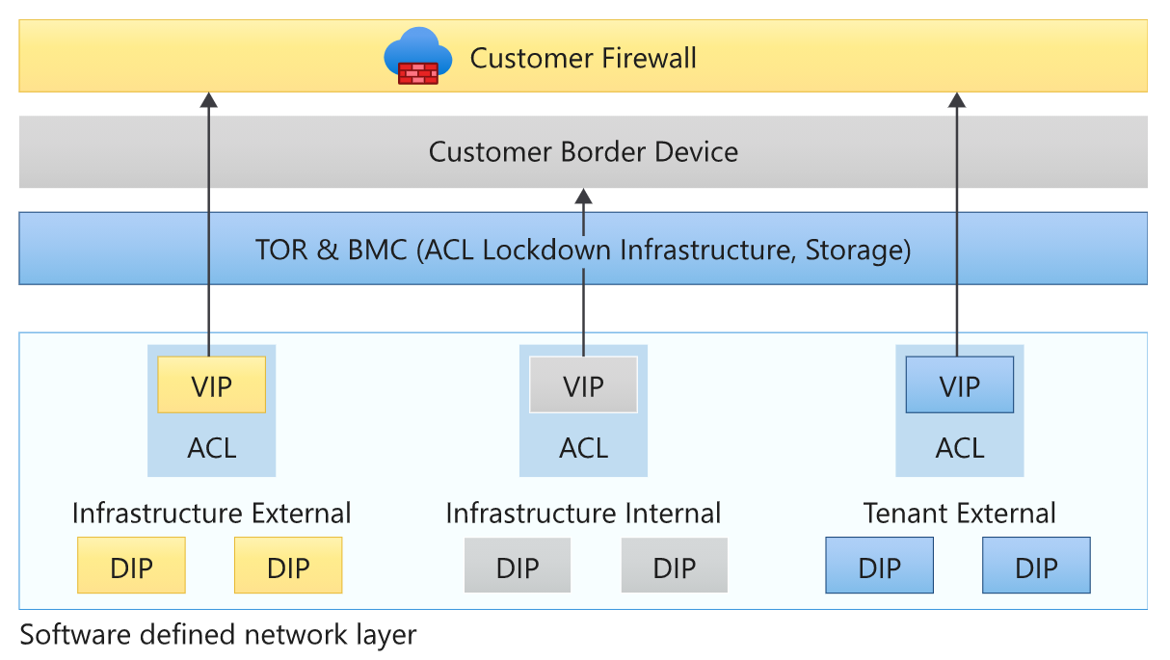
Firewall: Port requirements
Azure Stack Hub does not have a configurable setting to identify a proxy server.
You must have direct Internet access or a proxy that requires no client configuration

Slide 27
Enterprise/intranet/DMZ
Traditional enterprise deployment with DMZ between internal network and Internet
Options for connecting Azure Stack Hub to the DMZ are through firewall, NAT, and reverse proxy
Agg / Edge Router
Firewall
DMZ
Firewall/NAT/Proxy
ToR
BMC
ToR
Private
Storage & Infra VIPs
(10.11.128.0/24)
Private
Infrastructure Services
(10.11.130.0/24)
Service VIPs
Tenant VIPs
Public VIPs (65.53.123.0/22)
Azure Stack Hub

Slide 28
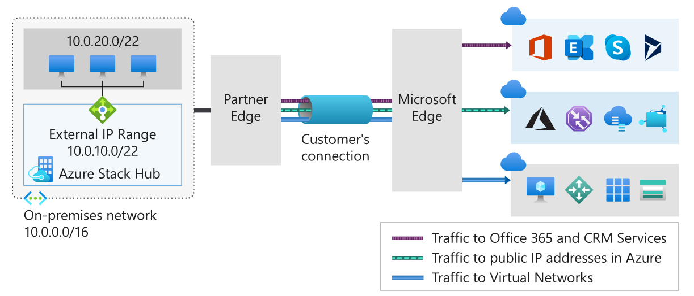
ExpressRoute for single tenant
Using Express Route - Azure Stack Hub | Microsoft Docs

Slide 29
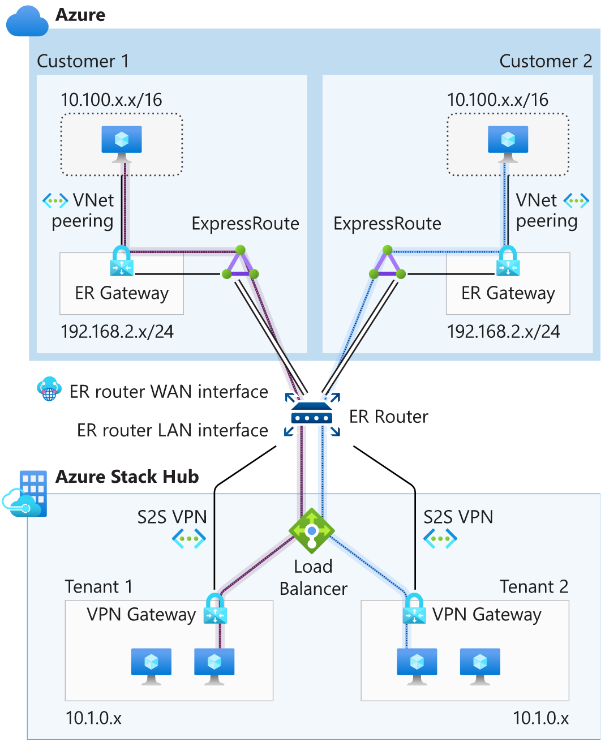
ExpressRoute for multi-tenant scenario
Each tenant create S2S VPN connection between Azure Stack Hub VNet and ER router
VNet’s from Azure are connected to ER router
The ER router LAN interface needs one IP address per Azure Stack Hub vnet
https://docs.microsoft.com/en-us/azure/azure-stack/azure-stack-connect-expressroute

Slide 30
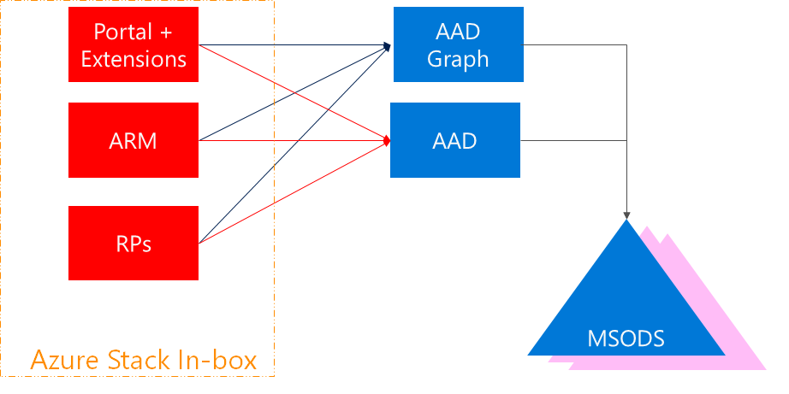
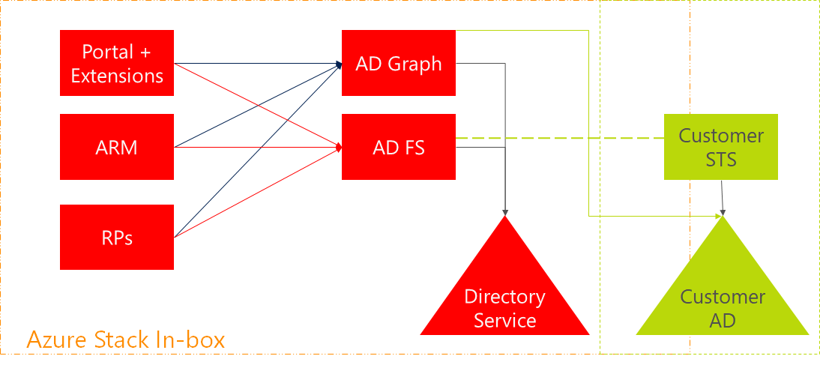
Portal authentication options
Identities from
Azure Active Directory AAD
Identities from existing
Corporate AD

Slide 31
Accessing Azure Stack Hub Portals today
Firewall
27 Ports
Portals : 443
Azure Stack Hub
User accesing Portal
Extensions : X
User hits https://portal.region.azurestack.external
Portal does redirect to AAD/ADFS to get a Token
If successfully authenticated, redirect back to https://portal.region.azurestack.external
Portal loads extensions by pointing user’s browser to https://portal.region.azurestack.external:ExtensionPort

Slide 32
Accessing Azure Stack Hub Portals with Extension Host
4 Ports
Firewall
User Portal : 443
Azure Stack Hub
User accesing Portal
User Extension Host : 443
*.hosting.region.fqdn
Extension X : X
Increased Security
Simplified Firewall Configuration (only TCP/443 is required for access)
Enables user to access Azure Stack Hub Portal via Proxy Server which may not support ports beyond 80 and 443
Faster adoption of new Azure services

Slide 33
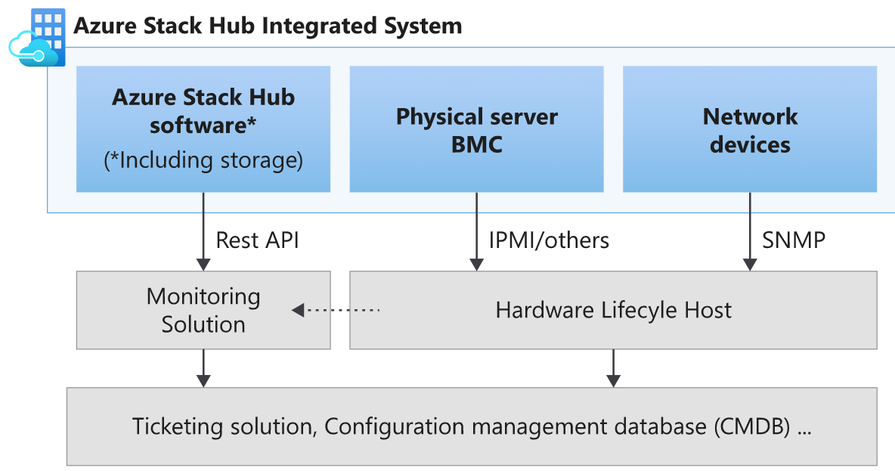
IT Service Management integration
Enable ITSM by adopting existing pipes
Monitor with existing datacenter monitoring tooling
Use existing connections from Monitoring to Ticketing, and others

Slide 34
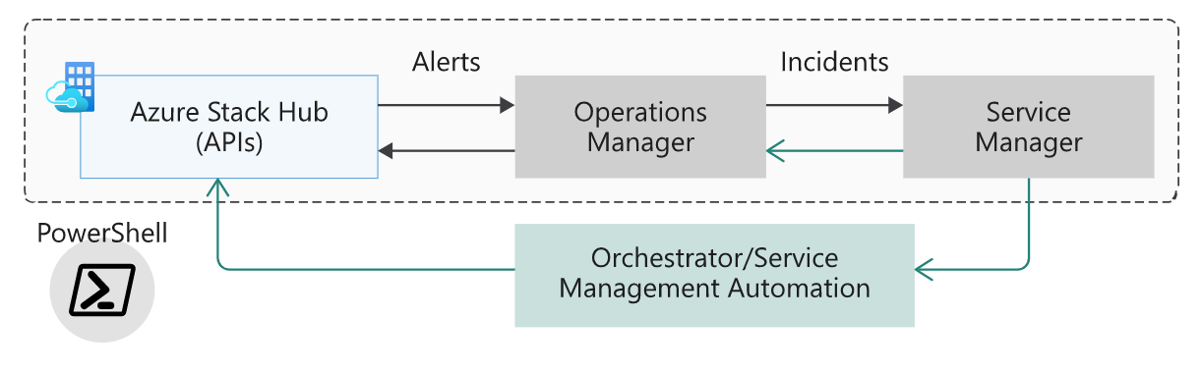
Operations Management & Nagios
Operations Management
External Monitoring for Azure Stack Hub
Manage multiple stacks with Operations Management Pack
Nagios
Monitoring Plug-in written in Python, calling REST API
Can also call multiple Stacks to retrieve and close alerts

Slide 35

Monitoring integration solutions
Azure Stack Hub Software API
System Center Operations Manager Management Pack
Nagios Plugin
Network Devices SNMP
Operations Management Suite (OMS)
Physical Server BMC
Tenant Subscription Health Monitoring
System Center Operations Manager Hardware Vendor Management Pack
System Center Operations Manager Network Device Discovery
Hardware Vendor Nagios Plugins
OEM supported monitoring solutions on HLH
Nagios Switch Plugin
API Examples & Documentation
OEM supported monitoring solutions on HLH

Slide 36

Security log integration
What logs are collected?
Windows System, Application, and Security Event logs
Active Directory Application and Diagnostic Logs
DNS Application and Diagnostic Logs
Other security-related events
How are they collected?
Azure Monitoring Agent
Where are they stored?
FRP – Storage Account (General Windows Event logs_)
Component Storage Account
How can I access the logs?
Storage Explorer (TP3)

Slide 37
Questions?

Slide 39
Appendix

Slide 40
Required firewall ports
Endpoint (VIP) | DNS host A record | Protocol | Ports
AD FS | Adfs.<region>.<fqdn> | HTTPS | 443
Portal (administrator) | Adminportal.<region>.<fqdn> | HTTPS | 443 12495 12499 12646 12647 12648 12649 12650 13001 13003 13010 13011 13020 13021 13026 30015

Slide 41
Required firewall ports
Endpoint (VIP) | DNS host A record | Protocol | Ports
Azure Resource Manager (administrator) | Adminmanagement.<region>.<fqdn> | HTTPS | 443 30024
Portal (user) | Portal.<region>.<fqdn> | HTTPS | 443 12495 12649 13001 13010 13011 13020 13021 30015 13003
Azure Resource Manager (user) | Management.<region>.<fqdn> | HTTPS | 443 30024
Graph | Graph.<region>.<fqdn> | HTTPS | 443
Certificate revocation list | Crl.<region>.<fqdn> | HTTP | 80
DNS | *.<region>.<fqdn> | TCP & UDP | 53

Slide 42
Required firewall ports
Endpoint (VIP) | DNS host A record | Protocol | Ports
Key Vault (user) | *.vault.<region>.<fqdn> | HTTPS | 443
Key Vault (administrator) | *.adminvault.<region>.<fqdn> | HTTPS | 443
Storage Queue | *.queue.<region>.<fqdn> | HTTP HTTPS | 80 443
Storage Table | *.table.<region>.<fqdn> | HTTP HTTPS | 80 443
Storage Blob | *.blob.<region>.<fqdn> | HTTP HTTPS | 80 443
SQL Resource Provider | sqladapter.dbadapter.<region>.<fqdn> | HTTPS | 44300-44304
MySQL Resource Provider | mysqladapter.dbadapter.<region>.<fqdn> | HTTPS | 44300-44304

